Slide 1

Monotonic Cardinality Estimation of Similarity Selection: A Deep Learning Approach
SIGMOD '20: Proceedings of the 2020 ACM SIGMOD
International Conference on Management
Data: June 2020
汇报人：张嘉文
Notes:
相似性选择的基数估计

Slide 2
Contents
Tasks
Framework
Model Design
Model Training
Accelerating
Dealing with Updates
Experiments
Summary

Slide 3
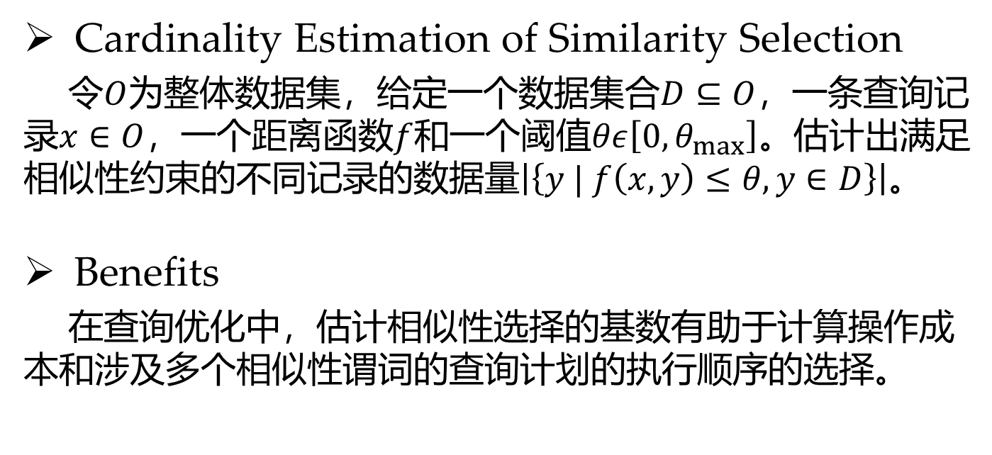
Tasks
Cardinality Estimation of Similarity Selection
令$O$为整体数据集，给定一个数据集合$D⊆O$，一条查询记录$x∈O$，一个距离函数$f$和一个阈值$θε\left[0,θ_{max}\right]。$估计出满足相似性约束的不同记录的数据量$\left|\left\{y | f\left(x,y\right)≤θ,y∈D\right\}\right|$。
Benefits
在查询优化中，估计相似性选择的基数有助于计算操作成本和涉及多个相似性谓词的查询计划的执行顺序的选择。

Slide 4
Tasks
Accuracy
Several other technical issues
(1) A good estimation is supposed to be fast.
(2) A generic method that applies to a variety of data types and distance functions is preferred.
(3) Users may want the estimated cardinality to be consistent and interpretable in applications like data exploration.

Slide 5
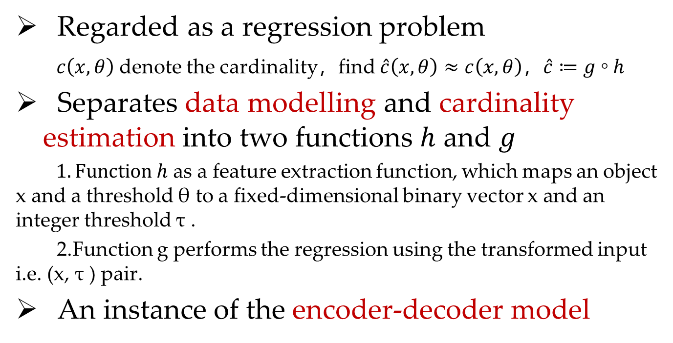
Framework
Regarded as a regression problem
$c\left(x,θ\right)$ denote the cardinality，find $\hat{c}\left(x,θ\right)≈c\left(x,θ\right)，\hat{c}≔g \text{◦} h$
Separates data modelling and cardinality estimation into two functions $h$ and $g$
$1.Function h$ as a feature extraction function, which maps an object x and a threshold θ to a fixed-dimensional binary vector x and an integer threshold τ .
2.Function g performs the regression using the transformed input i.e. (x, τ ) pair.
An instance of the encoder-decoder model

Slide 6
Framework
The rationales of such design:
(1)This allows the system to cater for different data types, and distance functions.
(2) It allows us to choose the best models for the estimation problem.
Decouple the two components:
(1) x belonging to a Hamming space
(2) τ is an non-negative integer.

Slide 7
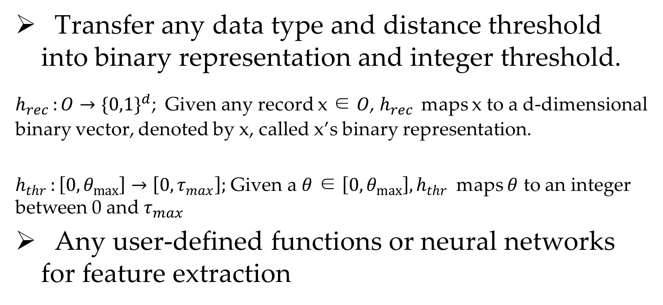
Model Design — Feature Extraction
Transfer any data type and distance threshold into binary representation and integer threshold.
$h_{rec }:O→{\{0,1\}}^{d}$; Given any record x ∈ $O$, $h_{rec }$maps x to a d-dimensional binary vector, denoted by x, called x’s binary representation.
$h_{thr }:\left[0,θ_{max}\right]→\left[0,τ_{max}\right];$ Given a $θ$ ∈ $\left[0,θ_{max}\right],h_{thr }$ maps $θ$ to an integer between 0 and $τ_{max}$
Any user-defined functions or neural networks for feature extraction

Slide 8
Model Design — Feature Extraction
Hamming Distance
Edit Distance
Jaccard Distance
Euclidean Distance
Using Hamming distance between binary representations would be a preferable option

Slide 9
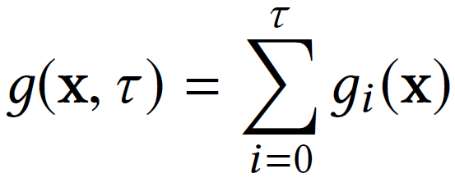
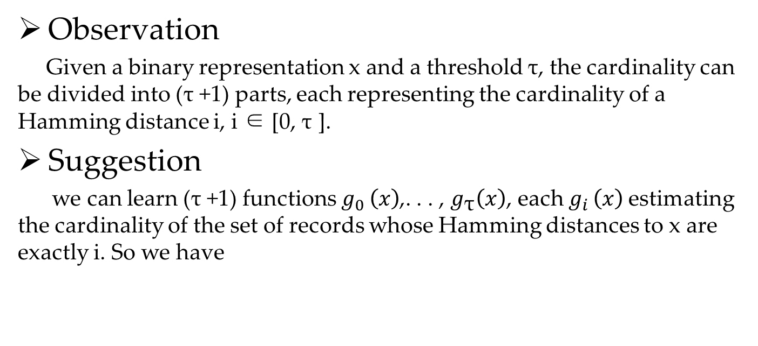
Model Design — Regression
Observation
Given a binary representation x and a threshold τ, the cardinality can be divided into (τ +1) parts, each representing the cardinality of a Hamming distance i, i ∈ [0, τ ].
Suggestion
we can learn (τ +1) functions $g_{0 }\left(x\right)$,. . . , $g_{\text{τ}}\left(x\right)$, each $g_{i }\left(x\right)$estimating the cardinality of the set of records whose Hamming distances to x are exactly i. So we have

Slide 10
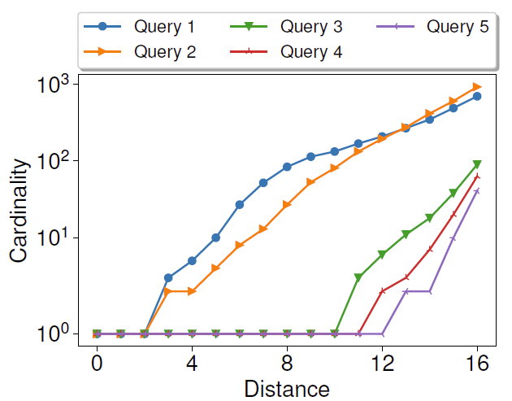
Model Design — Regression
Advantages
By using individual estimators, the distribution of each distance value can be learned separately to achieve better overall accuracy.
When the threshold increases from i to i + 1, the increased cardinality is the cardinality for distance i + 1. This incremental prediction can guarantee the monotonicity of cardinality estimation.

Slide 11
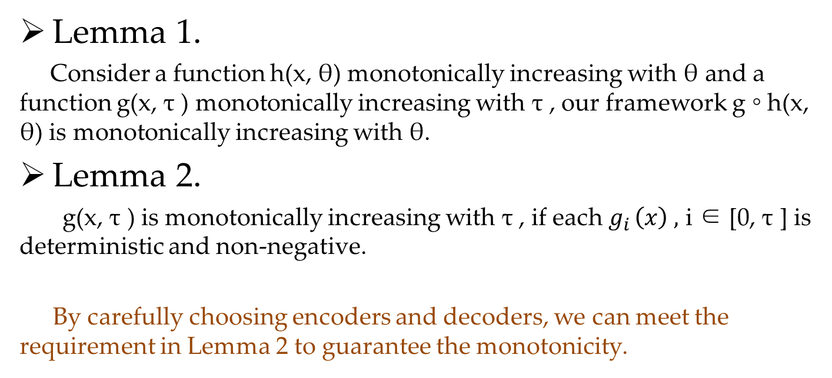
Model Design — Monotonic
Lemma 1.
Consider a function h(x, θ) monotonically increasing with θ and a function g(x, τ ) monotonically increasing with τ , our framework g ◦ h(x, θ) is monotonically increasing with θ.
Lemma 2.
g(x, τ ) is monotonically increasing with τ , if each $g_{i }\left(x\right) ,$ i ∈ [0, τ ] is deterministic and non-negative.
By carefully choosing encoders and decoders, we can meet the requirement in Lemma 2 to guarantee the monotonicity.

Slide 12
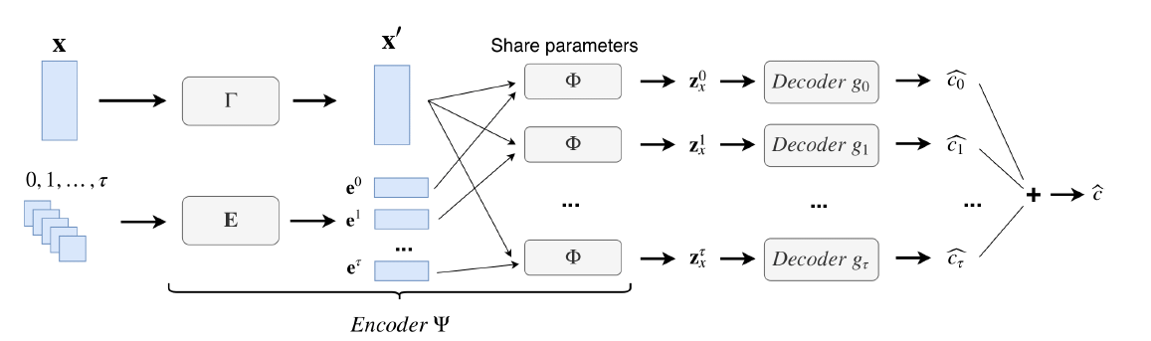



Model Design — Encoder-Decoder
for training
Online estimation
FNN

Slide 13
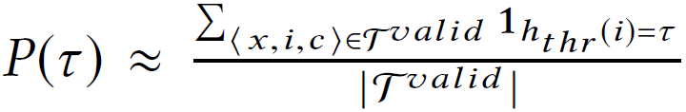
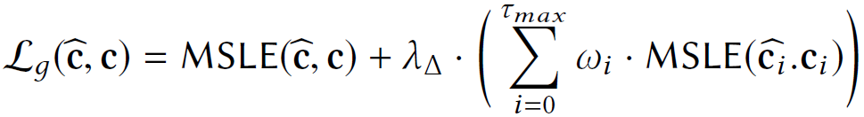
Model Training — Loss Function

Slide 14

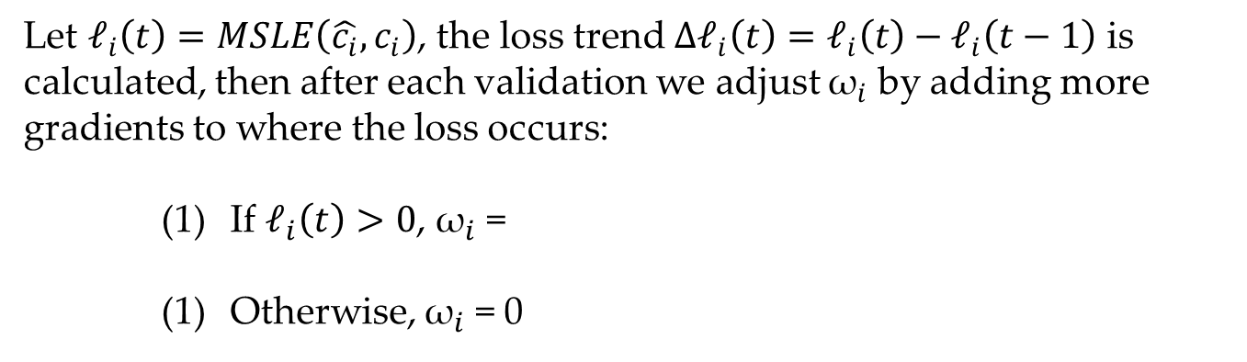
Model Training — Dynamic Training
Due to the non-convexity of ${\text{𝓛}}_{g}$ , it is difficult to find the correct direction of gradient that reaches the global or a good local optimum.
Let ${\text{𝓁}}_{i}\left(t\right)=MSLE\left(\hat{c_{i}},c_{i}\right)$, the loss trend $Δ{\text{𝓁}}_{i}\left(t\right)={\text{𝓁}}_{i}\left(t\right)−{\text{𝓁}}_{i}\left(t−1\right)$ is calculated, then after each validation we adjust ${\text{ω}}_{i}$ by adding more gradients to where the loss occurs:
If ${\text{𝓁}}_{i}\left(t\right)>0$, ${\text{ω}}_{i}$ =
Otherwise, ${\text{ω}}_{i}$ = 0

Slide 15
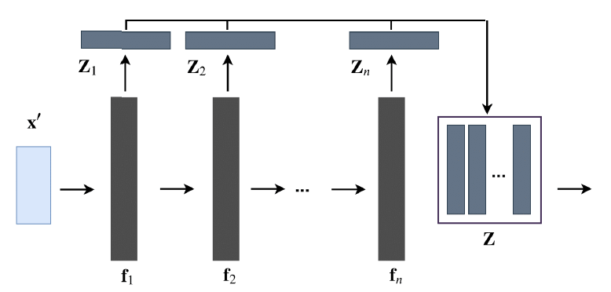
Accelerating
the computation cost from O((τ + 1)|Φ|) to O(|Φ′ |)

Slide 16
Dealing with updates
When the dataset is updated, the labels of the validation data are first updated by running a similarity selection algorithm on the updated dataset. Then we monitor the error (MSLE) in the validated data by running our model. If the error increases, we train our model with incremental learning:
First, the labels of the training data are updated by running a similarity selection algorithm on the updated dataset.
Then the model is trained with the updated training data until the validation error does not change for three consecutive epochs.
Note：
(1) the training does not start from scratch but from the current model, and it is processed on the entire training data to prevent catastrophic forgetting.
(2) we always keep the original queries and only update their labels.

Slide 17
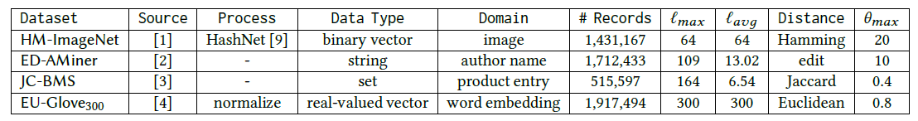
Experiments
Datasets:
Uniformly sample 10% data from dataset D as the query workload Q.
Split Q in 80: 10 : 10 to create training, validation and testing

Slide 18
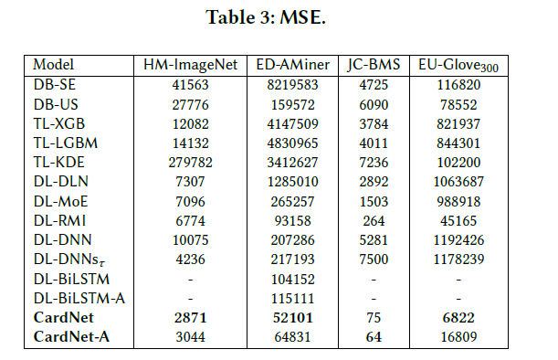
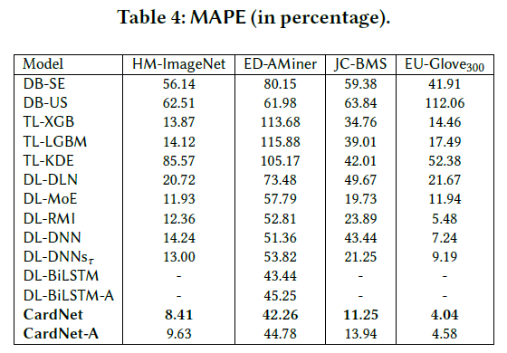
Experiments —Accuracy

Slide 19

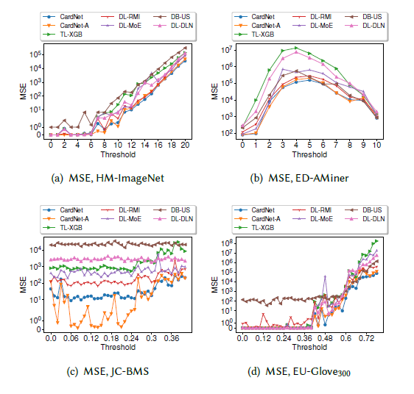
Experiments —Accuracy

Slide 20
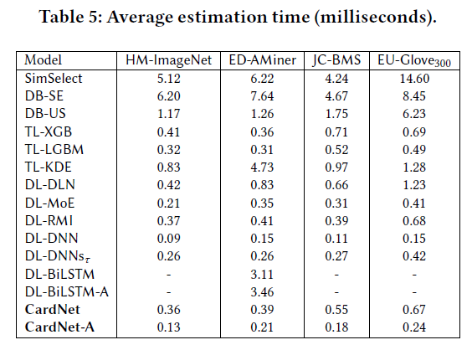
Experiments — Efficiency

Slide 21
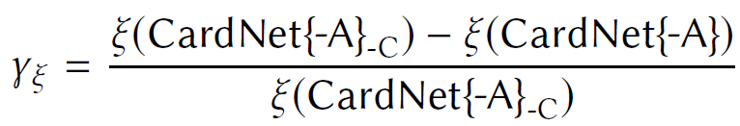
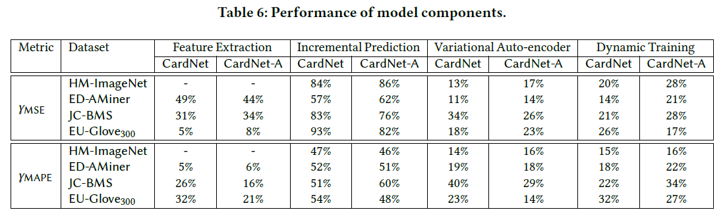
Experiments — Model Components

Slide 22
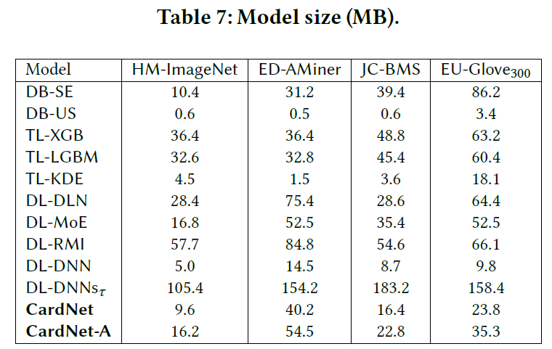
Experiments — Model Size

Slide 23
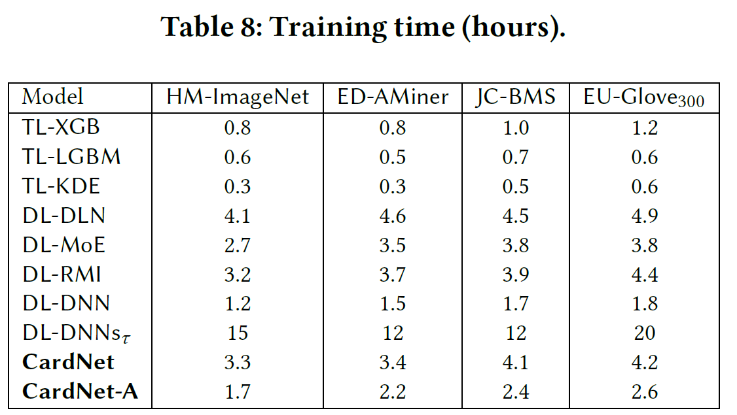
Experiments — Training

Slide 24
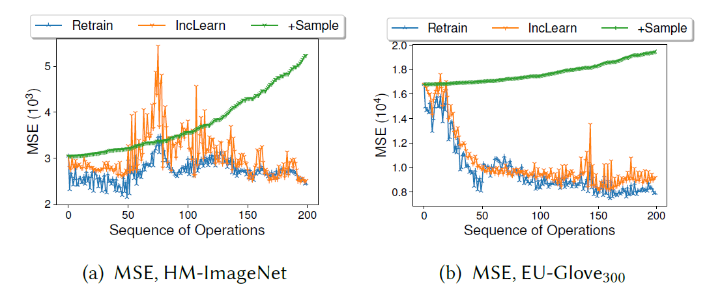
Experiments — Updates

Slide 25
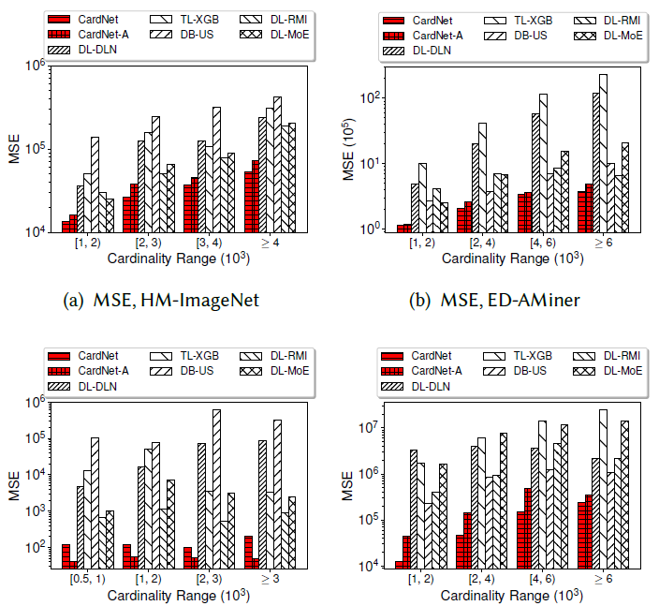
Experiments — Long-tail Queries

Slide 26
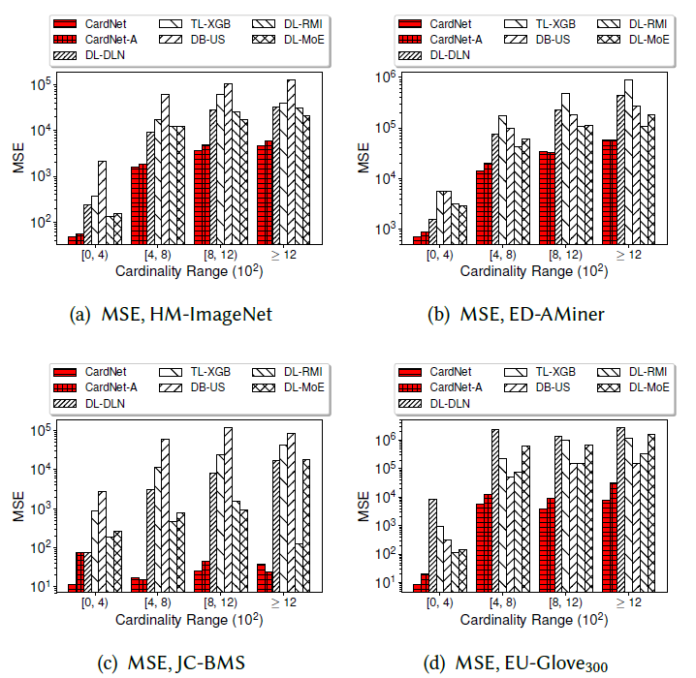
Experiments — Generalizability

Slide 27
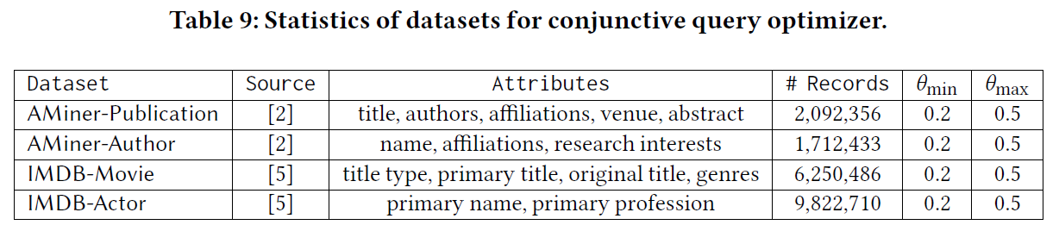
Experiments — Query Optimizer

Slide 28
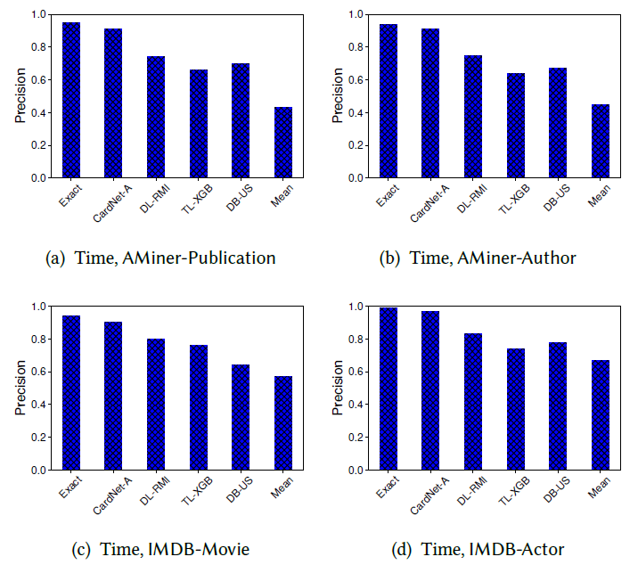
Experiments — Query Optimizer

Slide 29
Summary
Develop a deep learning method for cardinality estimation of similarity selection
Through feature extraction and regression, our method is generic to any data type and distance function
Accelerate our model for online estimation and propose incremental learning for updates
Conduct extensive experiments to demonstrate the superiority and the generalizability of our method

Slide 30
Thank you

